Slide 1
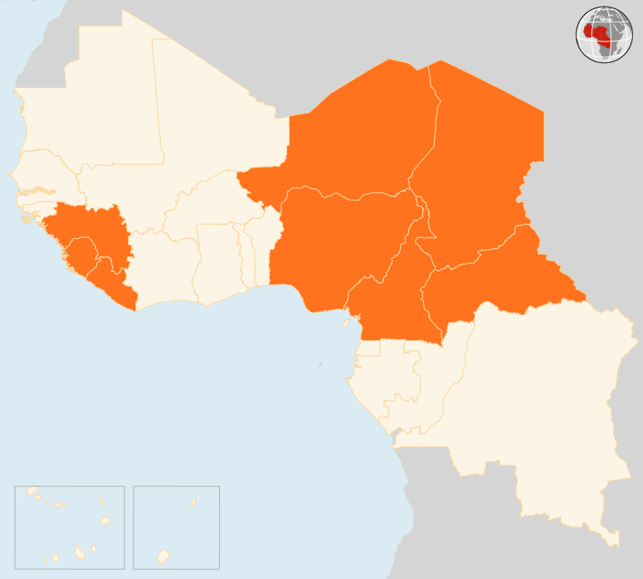

03 – 09 Nov 2015
CAMEROON
THREE KILLED IN SUICIDE BLAST
At least three people were killed and 19 others injured in a suicide attack on 9 November at a market in Fotokol locality in the Far North region. A second attacker was killed by security forces before detonating her explosive device. Boko Haram elements are suspected to be behind a series of suicide attacks that have rocked the Far North region since June.
CENTRAL AFRICAN REPUBLIC (CAR)
REFUGEES TO VOTE IN GENERAL ELECTIONS
The Central African Republic (CAR), Cameroon and UNHCR on 2 November signed a tripartite agreement that will allow more than 109,000 eligible CAR refugees in Cameroon to vote in the 27 December general elections aimed at ending the current transition government. Cameroon hosts around 250,000 CAR refugees in its East region neighbouring CAR.
CHAD
FIVE KILLED IN SUICIDE BOMBING
On 8 November, two suicide attackers struck Ngouboua village on the shores of Lake Chad, killing five people. Boko Haram is suspected to be behind the bombing by two young girls who detonated their explosives in a populated area. So far no population movements or humanitarian needs linked to the attack have been reported. In February, Ngouboua became the first Chadian village to be attacked by suspected Boko Haram gunmen.
NIGER
OVER 12,000 CHILDREN OUT OF SCHOOL IN DIFFA
A total of 151 schools have been closed in Niger’s south-eastern Diffa region due to insecurity and violence linked to Boko Haram. As a result, 12,631 children have been left without education as the new school year began in October. The Government and humanitarian organizations are working on ways to help the children return to school before the end of November.
NIGERIA
SEVEN KILLED IN TARABA
Violence erupted in Wukari town in Taraba State on 8 November following the annulment of the election of the incumbent governor. The State Emergency Management Authority and the Red Cross reported widespread violence and destruction of property during the violence that claimed seven lived and injured 16 others.
EVD REGIONAL
SIERRA LEONE DECLARED EBOLA-FREE
Sierra Leone was declared free of Ebola on 7 November, 42 days after the last confirmed case. The country recorded its first Ebola case in May 2014. Since then the virus has infected 8,704 people and killed 3,589. Sierra Leone has now begun a 90-day “enhanced surveillance period” to ensure early detection of any possible new cases. Guinea reported no cases in the week ending 8 November. Four Ebola patients are currently under treatment and 71 contacts are being monitored.
NIGER
12k
CHILDREN OUT OF SCHOOL
CHAD
5
KILLED IN SUICIDE ATTACK
NIGERIA
7
DIE IN VIOLENCE
CAR
REFUGEES TO VOTE IN POLLS
EVD REGIONAL
CAMEROON
SIERRA LEONE DECLARED EBOLA-FREE
3
KILLED IN SUICIDE BLAST
Creation date: 10 November 2015 Map data sources: UNCS, DevInfo, OCHA. Feedback: ocharowca@un.org
The boundaries and names shown and the designations used on this map do not imply official endorsement or acceptance by the United Nations.

